Slide 2
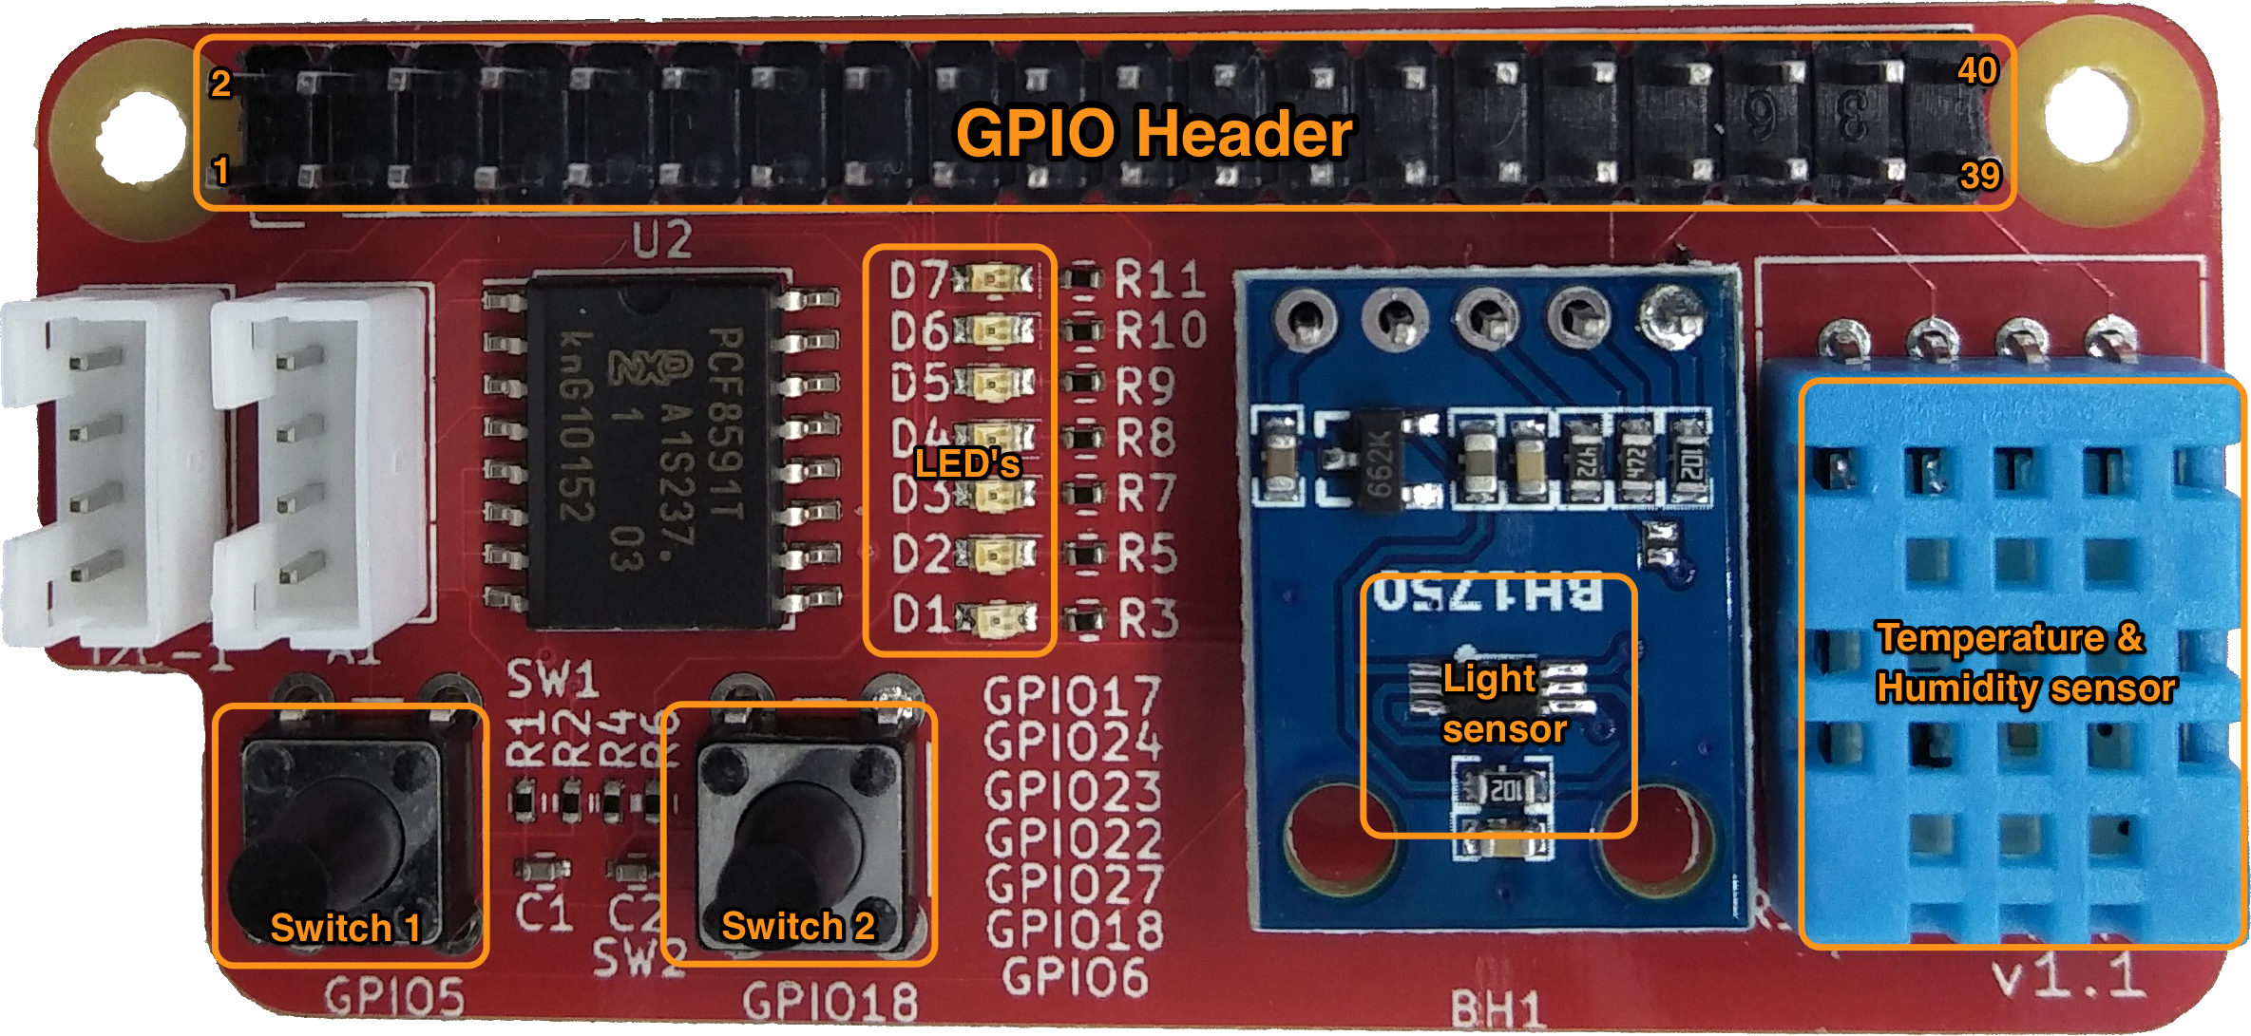
Node RED
Jupyter
Python
C, C++
MQTT
Switches
LED’s
Lightsensor
Humidity- Temperature sensor

